Slide 1
Q -DB : Document Status Monitor
what: Let’s spy on the Documents
where: @Hackathon
The Muppets

Slide 2
Who?
What?
Why?
The Muppets
AKA
@dare
@mto
@petrut.brailescu
@costin.pirosca
JMS & DB Spy
Application that gives you information about what’s going on in your Q and DB
To facilitate troubleshooting for both:
TS customers
and
Customer Support
&
Because we care? :)
* Were my documents already processed ?
*Are they stuck?

Slide 3
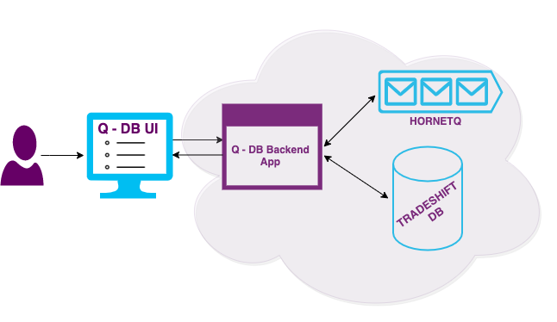
How ?
Notes:
UI Application displays messages with their currents status
UI App connects to Backend App, which basically can query DB and browse JMS queue to find all the documents this user has access to, gather their states and give back to the UI

Slide 4
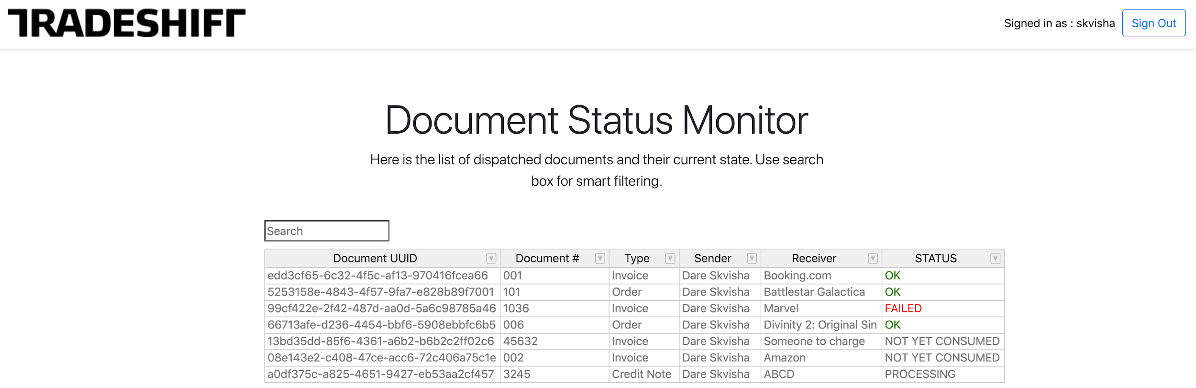
Leaked Image
Each column in sortable. Each column can be filtered by value
Notes:
you can sort by clicking on the column header
you can filter records by clicking on arrow next to the column title and selecting filtering logic

Slide 5

Demo Time ...

